Slide 1
A web-based GIS tool for exploring the world's biodiversity: The Global Biodiversity Information Facility Mapping and Analysis Portal Application (GBIF-MAPA)
Group 8: Ewelina Kwiatkowska, Katharina Kunstman, Jan Schwalb and Malte Simon
Keywords:
Biodiversity mapping, Online Geographic Information Systems, Species richness, Survey gap analysis, Global Biodiversity Information Facility

Slide 2
a. What were the main questions (or objectives) addressed?
Describe the Global Biodiversity Information Facility (GBIF)
Introduce the Mapping and Analysis Portal Application (MAPA)
Discuss application properties and use
Discuss development problems
Show exemplatory workflow
Give access to researchers to allow to use the whole spectrum of available data

Slide 3
b. How did the authors tackle them? (what did they do?)
-

Slide 4
c. What aspects could be added/done differently/problems?
Paper is from 2007 and the MAPA webpage is not available anymore

Slide 5
Introduction -ewelina
Technical issues -malte
Case studies (workflow) - jan
Conclusion - Katharina

Slide 6
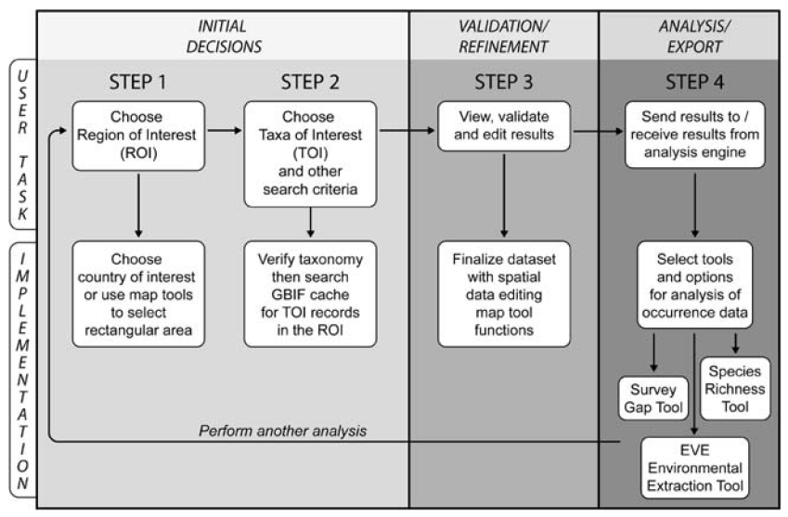

Workflow

Slide 7
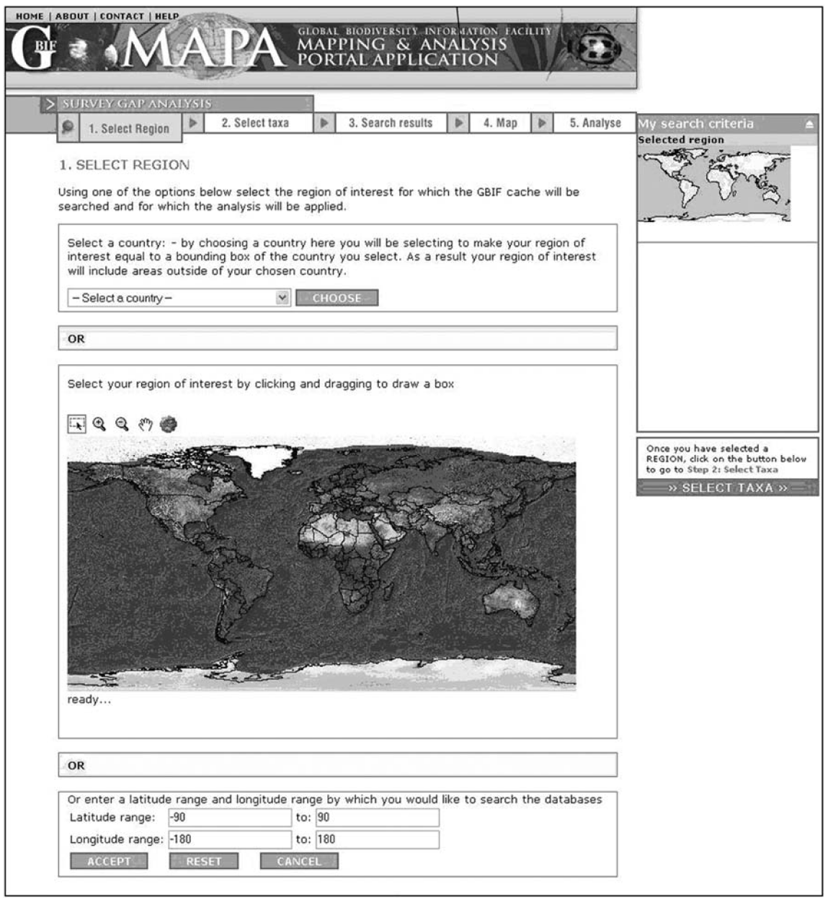

Application Interface

Slide 8
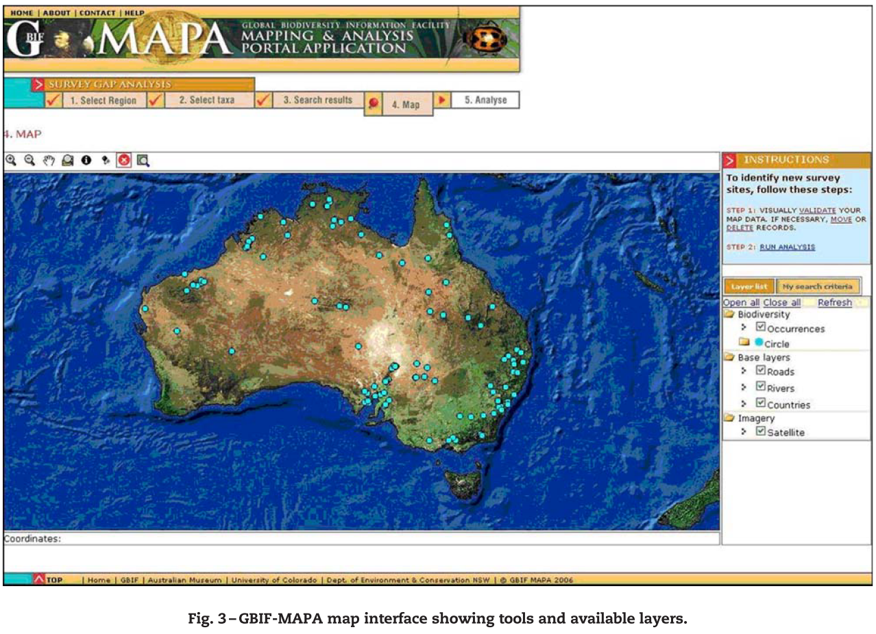
Map interface

Slide 9
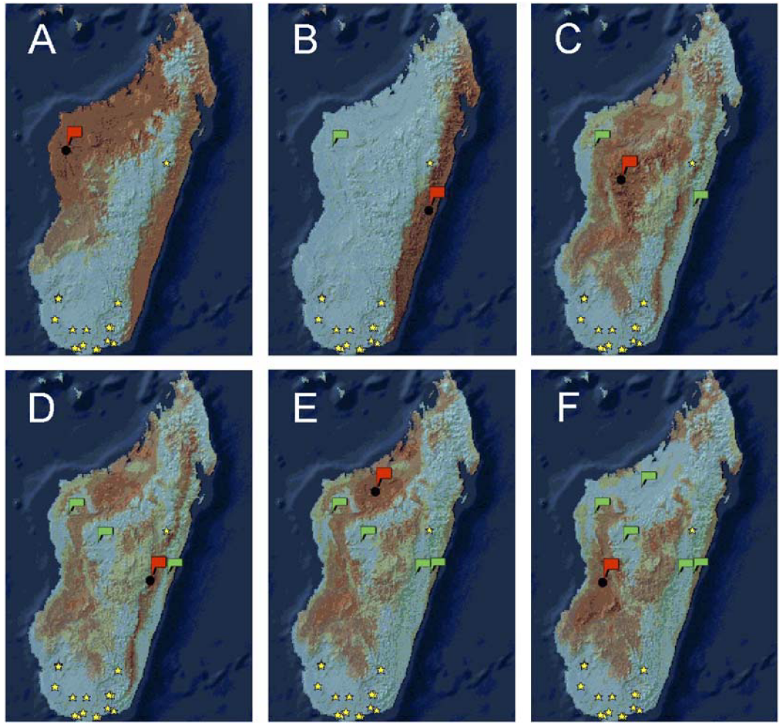
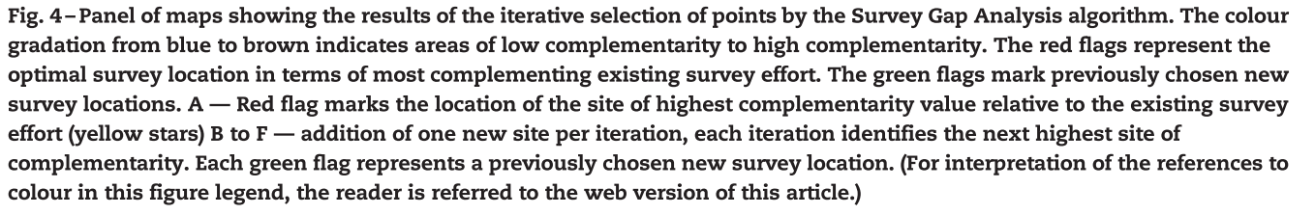
Survey gap analysis

Slide 10
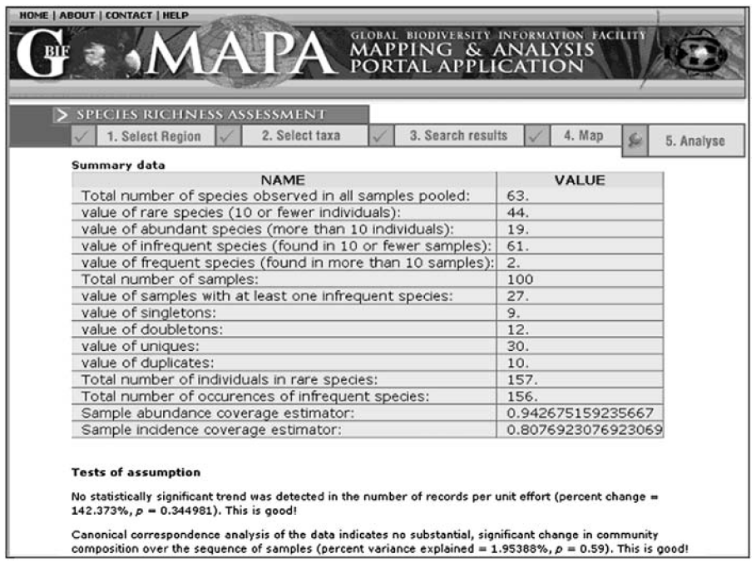

Tabular summary output

